Slide 1
Unit 4 Supervised Learning II
Classification
Logistic Regression
Decision Tree Regression and Classification
Random Forest Regression and Classification
Support Vector Machine Regression and Classification
Evaluating Classification Models.

Slide 3
Supervised Machine Learning
Supervised Machine Learning
Regression
Classification
Simple Linear
Logistic Regression
Multiple Linear
Decision Tree
Polynomial
Random Forest
Ridge Regression
Support Vector Machine
Lasso Regression
Decision Tree
Random Forest
Support Vector Machine

Slide 4
Decision tree regression
Decision Tree is one of the most commonly used, practical approaches for supervised learning.
Decision trees are constructed via an algorithmic approach that identifies ways to split a data set based on different conditions.
It is one of the most widely used and practical methods for supervised learning.
Decision Trees can be used for both classification and regression tasks.
Tree models where the target variable can take a discrete set of values are called classification trees.
Decision trees where the target variable can take continuous values (typically real numbers) are called regression trees.

Slide 5
Decision tree regression
Decision tree builds regression or classification models in the form of a tree structure.
It breaks down a dataset into smaller and smaller subsets while at the same time an associated decision tree is incrementally developed.
The final result is a tree with decision nodes and leaf nodes.
A decision node has two or more branches, each representing values for the attribute tested.
Leaf node represents a decision on the numerical target.
The topmost decision node in a tree which corresponds to the best predictor called root node.
Decision trees can handle both categorical and numerical data.

Slide 6
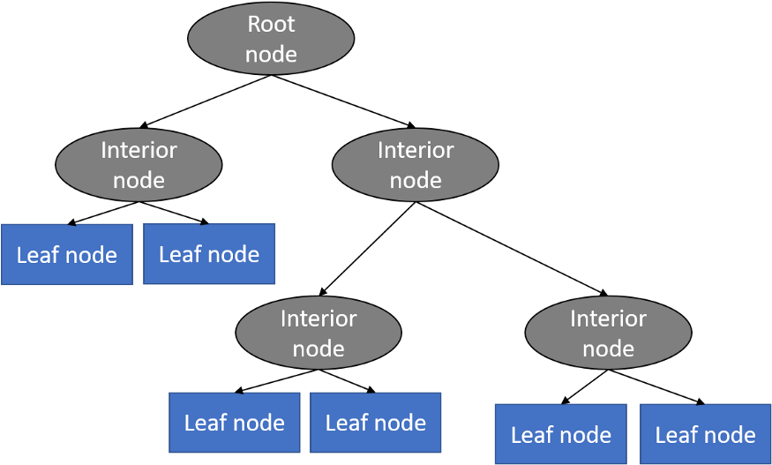
Decision tree structure

Slide 7
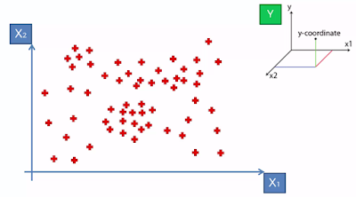
Decision tree example
Split 1
200
Split 3
170
Split 2
Split 4
20
40

Slide 8
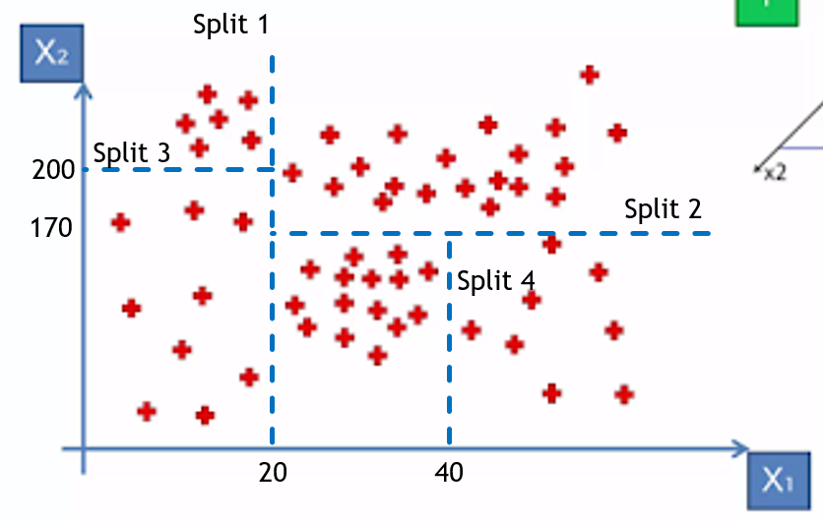
Decision tree example
X1<20
Yes
No
Yes
Yes
X2<200
X2<170
65.7
Yes
No
1023
Yes
No
300.5
65.7
X1<40
1023
300.5
Yes
No
-64.1
0.7
-64.1
0.7

Slide 9
Practical Activity

Slide 10
Decision Tree Regression: Advantages
Compared to other algorithms decision trees requires less effort for data preparation during pre-processing.
A decision tree does not require normalization of data.
A decision tree does not require scaling of data as well.

Slide 11
Decision Tree Regression: Disadvantages
A small change in the data can cause a large change in the structure of the decision tree causing instability.
For a Decision tree sometimes calculation can go far more complex compared to other algorithms.
Decision tree often involves higher time to train the model.

Slide 13
Ensemble Learning
An Ensemble method is a technique that combines the predictions from multiple machine learning algorithms together to make more accurate predictions than any individual model.
A model comprised of many models is called an Ensemble model.

Slide 14
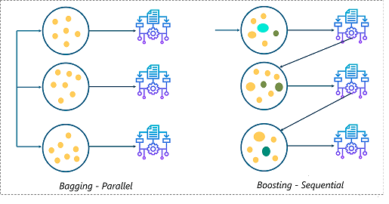
Ensemble Learning

Slide 15
Ensemble Learning: Types
Boosting
Types of Ensemble Learning
Bootstrap Aggregation (Bagging).

Slide 16
Ensemble Learning: Types
Boosting
Types of Ensemble Learning
Bootstrap Aggregation (Bagging).

Slide 17
Bootstrap Aggregation (Bagging)
Bagging, also known as Bootstrap Aggregation, is the ensemble technique used by random forest.
Bagging chooses a random sample/random subset from the entire data set.
Hence each model is generated from the samples (Bootstrap Samples) provided by the Original Data with replacement known as row sampling.
This step of row sampling with replacement is called bootstrap.
Now each model is trained independently, which generates results.
The final output is based on majority voting after combining the results of all models.
This step which involves combining all the results and generating output based on majority voting, is known as aggregation.

Slide 18
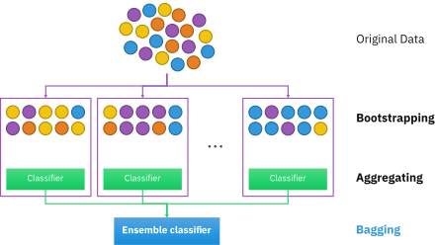

Slide 19
Boosting
Boosting is one of the techniques that use the concept of ensemble learning.
A boosting algorithm combines multiple simple models (also known as weak learners or base estimators) to generate the final output.
It is done by building a model by using weak models in series.
There are several boosting algorithms; AdaBoost was the first really successful boosting algorithm that was developed for the purpose of binary classification.
AdaBoost is an abbreviation for Adaptive Boosting and is a prevalent boosting technique that combines multiple “weak classifiers” into a single “strong classifier.”

Slide 20
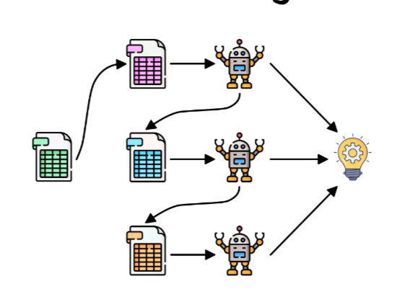

Slide 21
Random Forest regression
Random forest is a Supervised Learning algorithm which uses ensemble learning method for classification and regression.
Random forest is a bagging technique and not a boosting technique.
The trees in random forests are run in parallel.
There is no interaction between these trees while building the trees.
It operates by constructing a multiple of decision trees at training time and predocs the output that is the mean prediction (regression) of the individual trees.

Slide 22
Random Forest Regression: Steps
Pick at random k data points from the training set.
Build a decision tree associated to these k data points.
Choose the number N of trees you want to build and repeat steps 1 and 2.
For a new data point, make each one of your N-tree trees predict the value of y for the data point in question and assign the new data point to the average across all of the predicted y values.

Slide 23
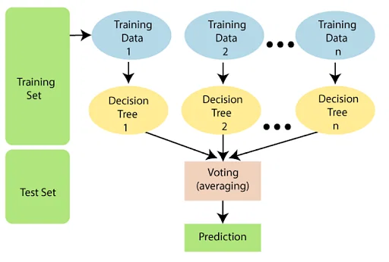
Random Forest regression overview

Slide 24
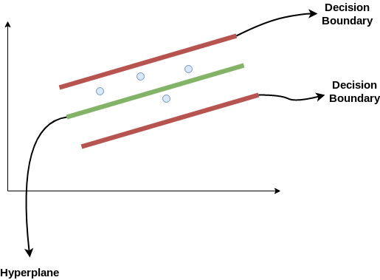
Support Vector Machine Regression
SVR is built based on the concept of Support Vector Machine or SVM(Support Vector Machine).
SVM is one among the popular Machine Learning models that can be used in classification problems or assigning classes when the data is not linearly separable.
As the name suggest the SVR is an regression algorithm , so we can use SVR for working with continuous Values instead of Classification which is SVM.

Slide 26
Hyperplane
In SVM this is basically the separation line between the data classes.
Although in SVR we are going to define it as the line that will help us predict the continuous value or target value
Boundary line
In SVR like SVM there are two lines other than Hyper Plane which creates a margin .
The support vectors can be on the Boundary lines or outside it.
This boundary line separates the two classes
Support vectors
These are the data points which are closest to the boundary.
The distance of the points is minimum or least.
Kernel
The function used to map a lower dimensional data into a higher dimensional data.

Slide 27
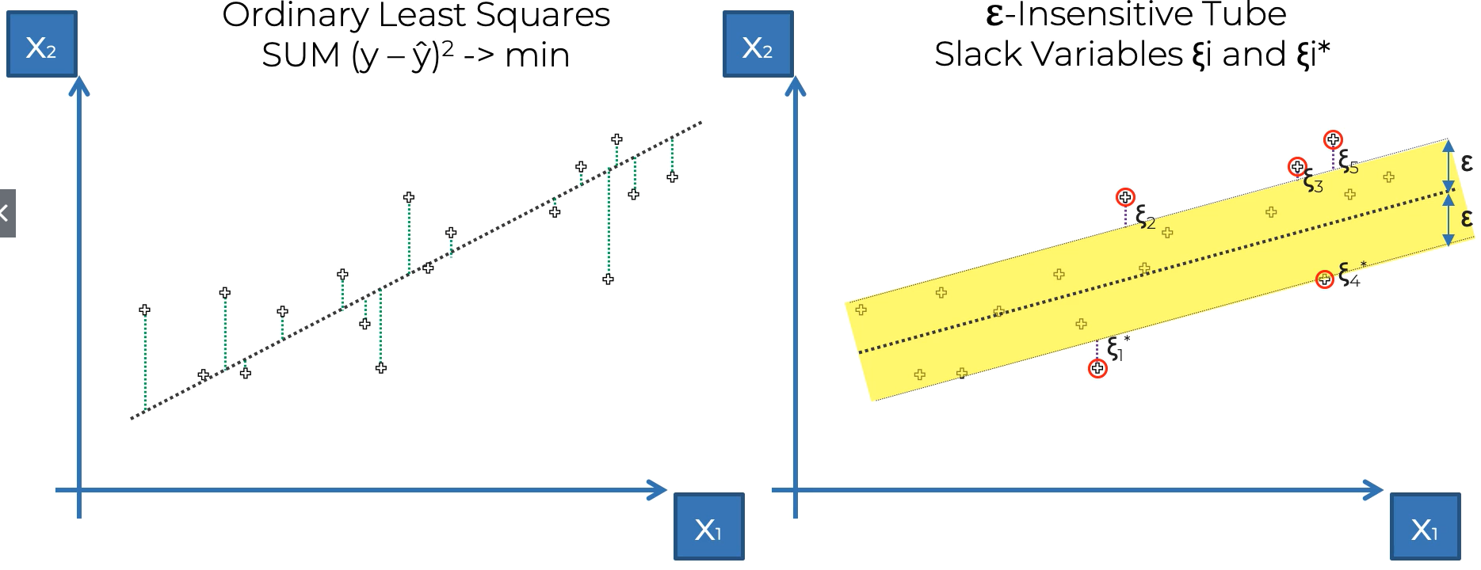
Simple Linear regression and SVR

Slide 28
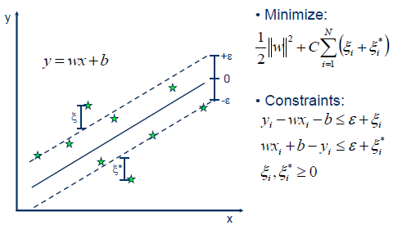
SVR

Slide 29
SVR equation
Assuming that equation of hyperplane is
y= wx+b
Where,
y is the dependent variable
x is the input feature
w is the weight (slope) of the hyperplane, which SVR tries to learn during training.
b is the bias (intercept) of the hyperplane, which is also learned during training.

Slide 30
Then the equation of upper decision boundary became
wx+b= +a
Then the equation of lower decision boundary became
wx+b=-a
In above equation a represents the margin
Tolerance ,also know as epsilon-intensive tube.
This parameter defines the width of the tube
around the regression line, within which errors
are considered acceptable.
In other words, it specifies how much deviation from the regression line is allowed before a data point is considered an error.

Slide 31
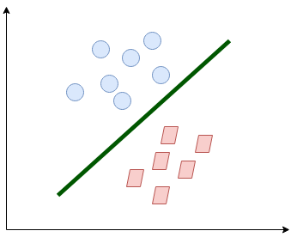
Kernel
By default SVR uses linear kernel, which can only capture linear relationship between the features and target variable

Slide 32
Kernel
However , in many real word problems the relationship between the input features and the target variable is not linear. By transforming the data into a higher-dimensional space using non-linear kernels (e.g., polynomial or radial basis function), SVR can capture and model non-linear relationships.
SVR's primary goal is to find a hyperplane that maximizes the margin while minimizing prediction errors. In a higher-dimensional space, the data points may become more separable, making it easier to find a hyperplane that maximizes the margin.

Slide 33
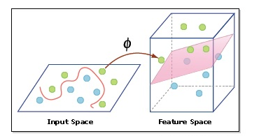
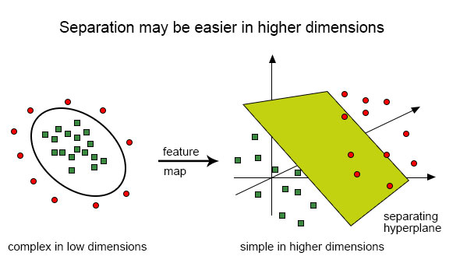

Slide 34
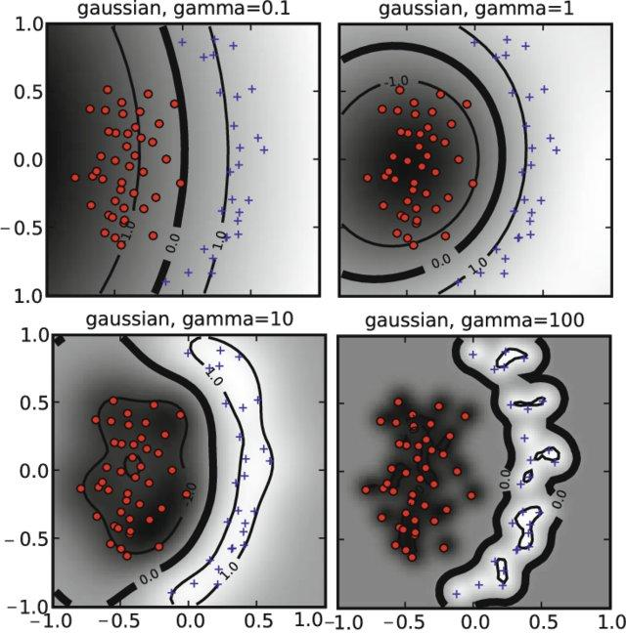
Reference :Ben-Hur, Asa, Cheng Soon Ong, Sören Sonnenburg, Bernhard Schölkopf, and Gunnar Rätsch. "Support vector machines and kernels for computational biology." PLoS computational biology 4, no. 10 (2008): e1000173.

Slide 35
Types of Kernel
Linear : Linear data
Polynomial : non linear
Radial Basis Function (RBF) : Highly Non linear

Slide 36
Classification
Supervised Machine Learning
Classification
Logistic Regression
Decision Tree
Random Forest
Support Vector Machine

Slide 37
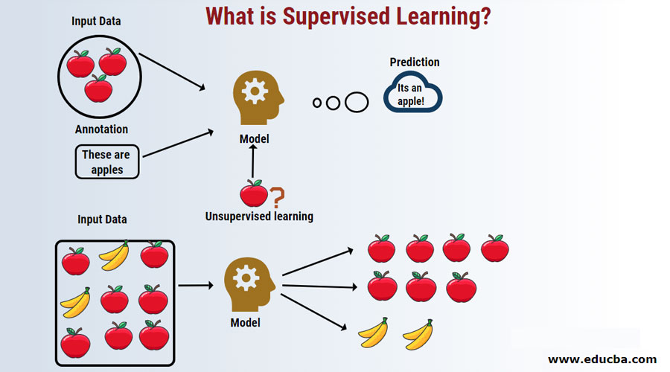
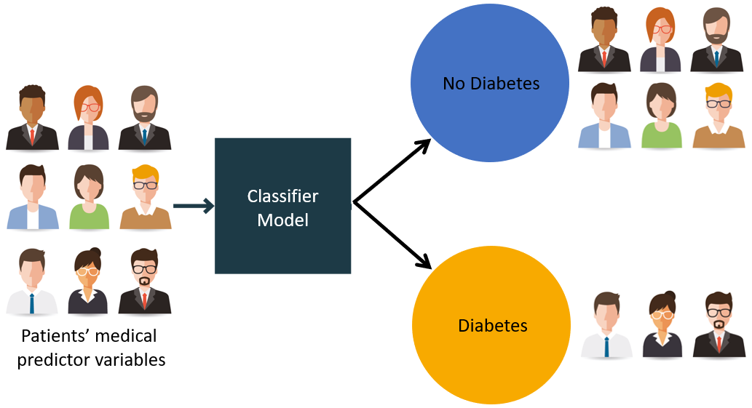
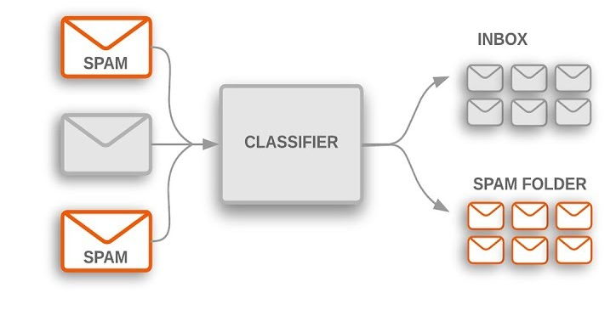
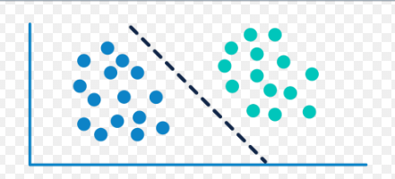
Classification Examples

Slide 38
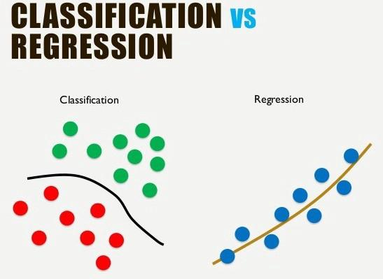
Regression Vs Classification
Classification predicts the category the data belongs to
Regression predicts a numerical values based on previously observed data

Slide 39
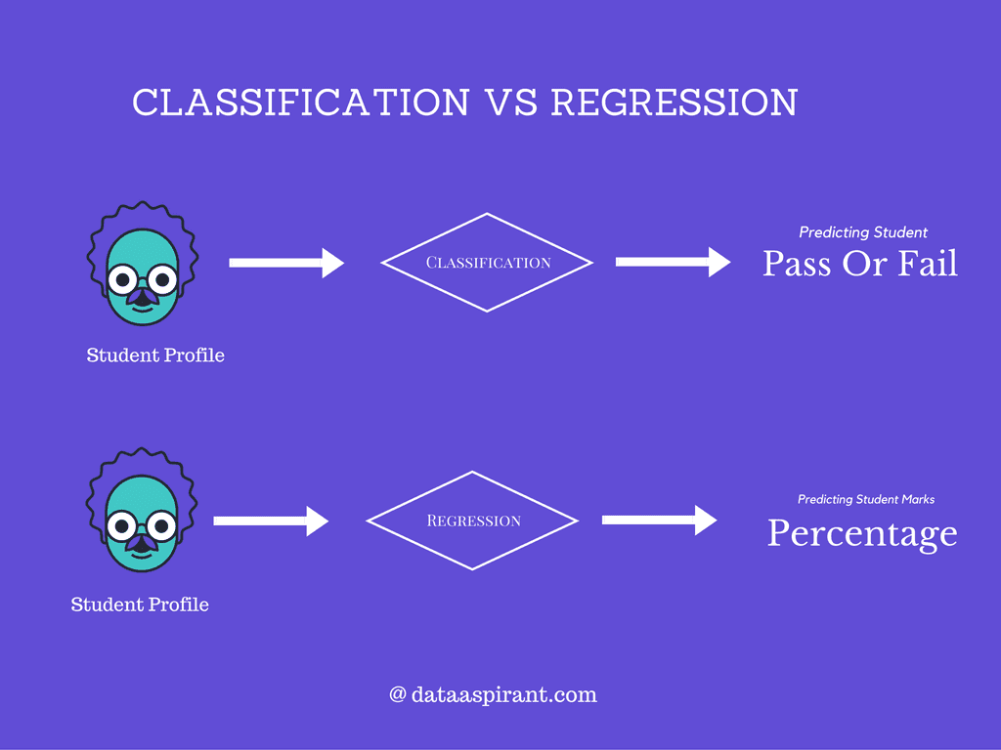
Regression Vs Classification

Slide 40
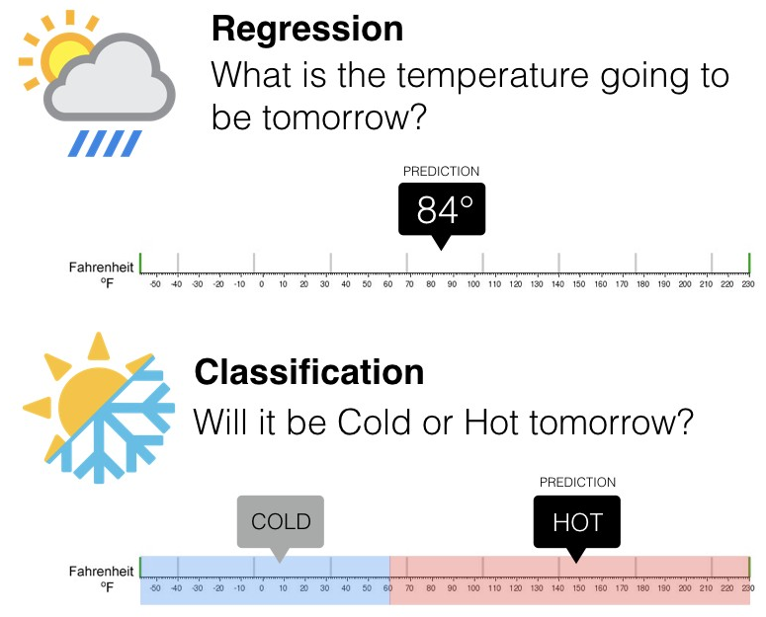
Regression Vs Classification

Slide 41
Classification
Classification is a supervised machine learning method where the model tries to predict the correct label of a given input data.

Slide 42
Classification Process
Classification is a two step process:
Learning step (or training phase)
Where a classification algorithm builds the classifier by analyzing or “learning from” a training set made up of database tuples and their associated class labels.
A tuple, X, is represented by an n-dimensional attribute vector, X = (x1, x2,..., xn), depicting n measurements made on the tuple from n database attributes, respectively, A1, A2,..., An.
Each tuple, X, is assumed to belong to a predefined class as determined by another database attribute called the class label attribute.

Slide 43
The class label attribute is discrete-valued and unordered, it is categorical (or nominal) in that each value serves as a category or class.
The individual tuples making up the training set are referred to as training tuples
Because the class label of each training tuple is provided, this step is also known as supervised learning.
The classifier or model generated in the first step of classification algorithm can be a classification rules, decision trees, or mathematical formulae.

Slide 44
Classification Process
II classification step (or Testing Phase)
In second step the model is used for classification, first it is used on a test data to check its accuracy.
Estimate accuracy of the model ,the known label of test sample is compared with the classified result from the model
Accuracy rate is the percentage of test set samples that are correctly classified by the model
Test set is independent of training set, otherwise over-fitting will occur
If the accuracy is acceptable, use the model to classify data tuples whose class labels are not known

Slide 45
Classification : Example
Class label
Attributes
Patient Id | Sore throat | Fever | Swollen Glands | Congestion | Headache | Diagnosis
1 | Yes | Yes | Yes | Yes | Yes | Strep throat
2 | No | No | No | Yes | Yes | Allergy
3 | Yes | Yes | No | Yes | No | Cold
4 | Yes | No | No | No | No | Strep throat
5 | No | Yes | No | Yes | No | Cold
6 | No | No | No | Yes | No | Allergy
7 | No | No | Yes | No | No | Strep throat
8 | Yes | No | No | Yes | Yes | Allergy
9 | No | Yes | No | Yes | Yes | Cold
10 | Yes | Yes | No | Yes | Yes | Cold

Slide 46
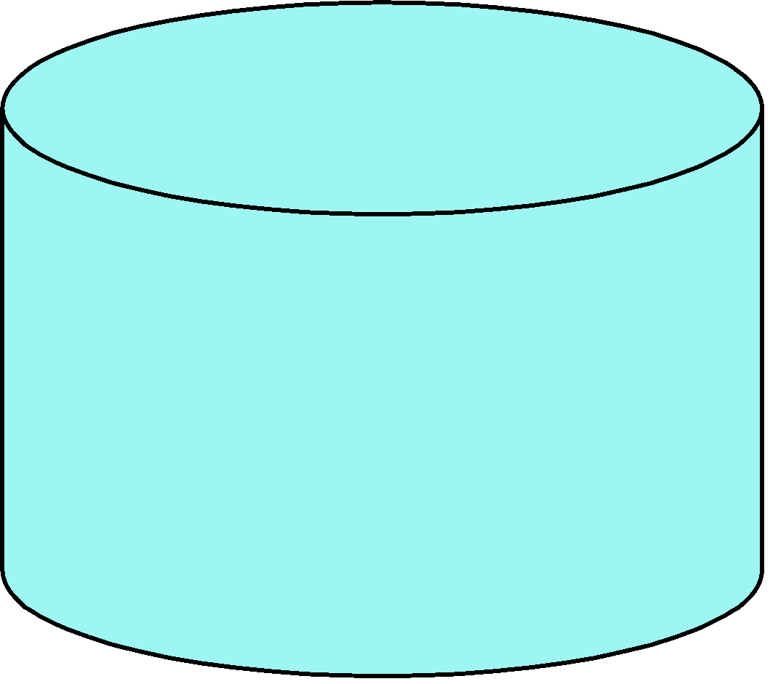
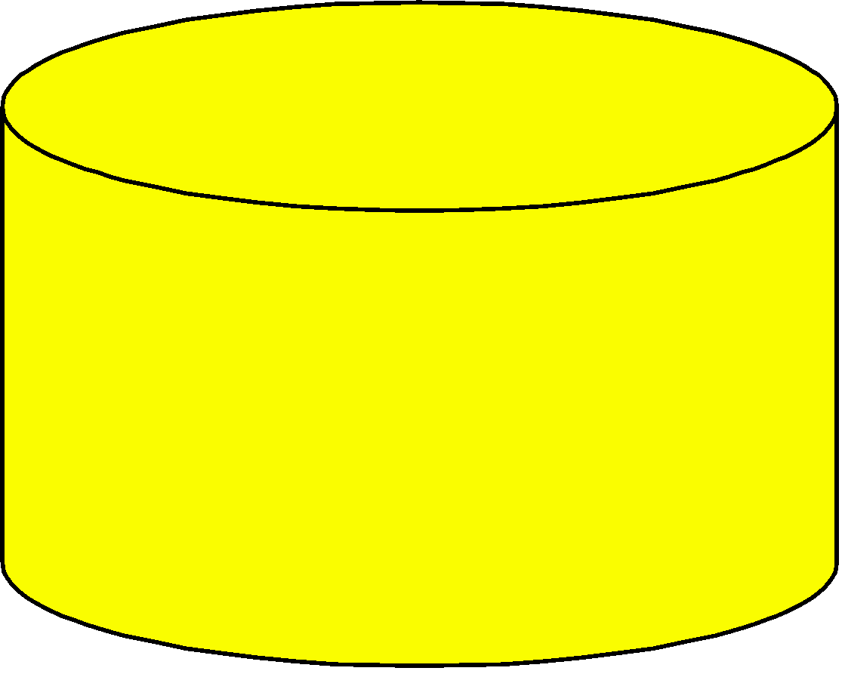
Step I: Learning step (or training phase)
Classification
Algorithms
Training
Data
Patient Id | Sore throat | Fever | Swollen Glands | Congestion | Headache | Diagnosis
1 | Yes | Yes | Yes | Yes | Yes | Strep throat
2 | No | No | No | Yes | Yes | Allergy
3 | Yes | Yes | No | Yes | No | Cold
4 | Yes | No | No | No | No | Strep throat
5 | No | Yes | No | Yes | No | Cold
6 | No | No | No | Yes | No | Allergy
7 | No | No | Yes | No | No | Strep throat
8 | Yes | No | No | Yes | Yes | Allergy
9 | No | Yes | No | Yes | Yes | Cold
10 | Yes | Yes | No | Yes | Yes | Cold
Classifier
(Model)
Swollen
Glands
No
Yes
Fever
Diagnosis=Strep Throat
No
Yes
Diagnosis=Allergy
Diagnosis =Cold

Slide 47
Step II : Classification step (or testing phase)
Swollen
Glands
No
Yes
Test
Data
Fever
Diagnosis=Strep Throat
No
Yes
Diagnosis=Allergy
Diagnosis =Cold
Patient Id | Sore throat | Fever | Swollen Glands | Congestion | Headache | Diagnosis
1 | Yes | Yes | Yes | Yes | Yes | Strep throat
2 | No | No | No | Yes | Yes | Allergy
3 | Yes | Yes | No | Yes | No | Cold
4 | Yes | No | No | No | No | Strep throat
5 | No | Yes | No | Yes | No | Cold
6 | No | No | No | Yes | No | Allergy
7 | No | No | Yes | No | No | Strep throat
8 | Yes | No | No | Yes | Yes | Allergy
9 | No | Yes | No | Yes | Yes | Cold
10 | Yes | Yes | No | Yes | Yes | Cold
Accurate ?
Use model
Update model

Slide 48
Classification Terminologies
Classifier: An algorithm that maps the input data to a specific category.
Classification model: A classification model tries to draw some conclusion from the input values given for training. It will predict the class labels/categories for the new data.
Feature: A feature is an individual measurable property of a phenomenon being observed.
Binary Classification: Classification task with two possible outcomes. E.g.: Gender classification (Male / Female)

Slide 49
Classification Terminologies
Multi-class classification: Classification with more than two classes. In multi class classification each sample is assigned to one and only one target label. E.g.: An animal can be cat or dog but not both at the same time
Multi-label classification: Classification task where each sample is mapped to a set of target labels (more than one class). E.g.: A news article can be about sports, a person, and location at the same time.

Slide 50
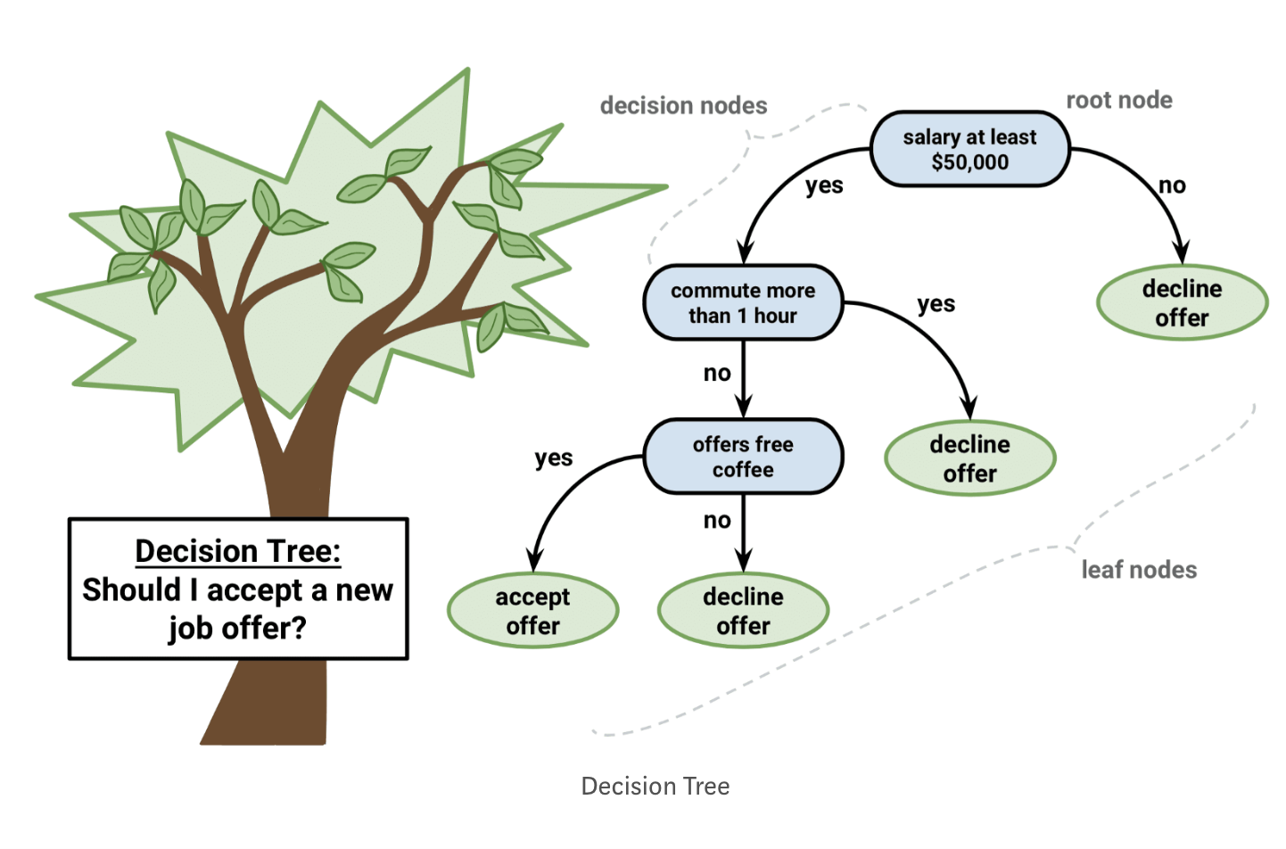
Decision Tree Classification

Slide 51
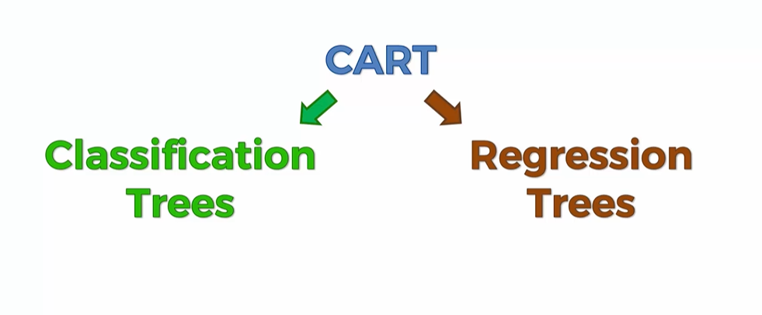
Decision Tree Classification

Slide 52
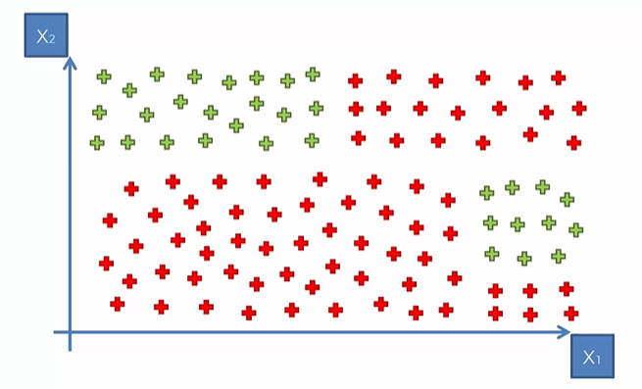
Decision Tree : How it works?
Split 2
60
Split 3
Split 1
0
Split 4
50
70

Slide 53
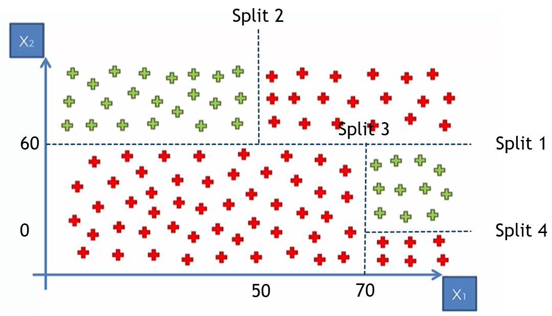
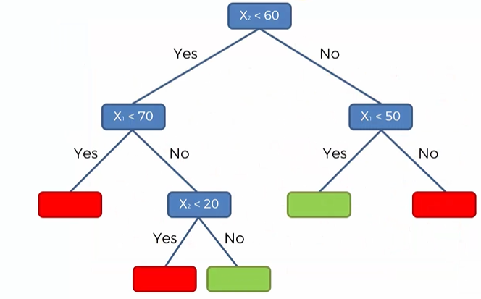
Decision Tree : How it works?

Slide 54
Decision tree classifier
Decision Tree is a Supervised learning technique that can be used for both classification and Regression problems, but mostly it is preferred for solving Classification problems.
It is a tree-structured classifier, where internal nodes represent the features of a dataset, branches represent the decision rules and each leaf node represents the outcome.
In a Decision tree, there are two nodes, which are the Decision Node and Leaf Node.
Decision nodes are used to make any decision and have multiple branches, whereas Leaf nodes are the output of those decisions and do not contain any further branches.
The decisions or the test are performed on the basis of features of the given dataset.

Slide 55
Decision tree classifier
Decision Tree is a Supervised learning technique that can be used for both classification and Regression problems, but mostly it is preferred for solving Classification problems.
It is a tree-structured classifier, where internal nodes represent the features of a dataset, branches represent the decision rules and each leaf node represents the outcome.
In a Decision tree, there are two nodes, which are the Decision Node and Leaf Node.
Decision nodes are used to make any decision and have multiple branches, whereas Leaf nodes are the output of those decisions and do not contain any further branches.
The decisions or the test are performed on the basis of features of the given dataset.

Slide 56
Advantages of decision tree classifier
Extremely fast at classifying unknown records.
Easy to interpret for small-sized trees
Accuracy comparable to other classification techniques for many simple data sets.
Excludes unimportant features.

Slide 57
Disadvantages of decision tree classifier
Easy to overfit.
Decision tree models are often biased toward splits on features having a large number of levels.
Small changes in the training data can result in large changes to decision logic.

